Slide 1


INVESTORS CONFERENCE CALL
For the year ended 31 March 2023
Presented by: Amar Kulkarni, CFO

Slide 2
ABOUT US
Widam Food Company Q.P.S.C. (the “Company”) was incorporated in accordance with the Resolution No. 75 of 2003 issued by the Minister of Economy and Finance of the State of Qatar as a Qatari Public Shareholding Company, and was registered at the Ministry of Economy and Commerce of the State of Qatar with the Commercial Registration No. 26911 dated 16 December 2003. The Company is domiciled in the State of Qatar, where it also has its principal place of business. Its registered office is at Fifth floor, Al Shomoukh Tower, Al Saad, Doha.
The Company’s principal activities include the import and trade of livestock, meat and feeds. In addition the Company is engaged in the slaughter of sheep and cattle and supplying the local market with fresh meat and related products

Slide 3
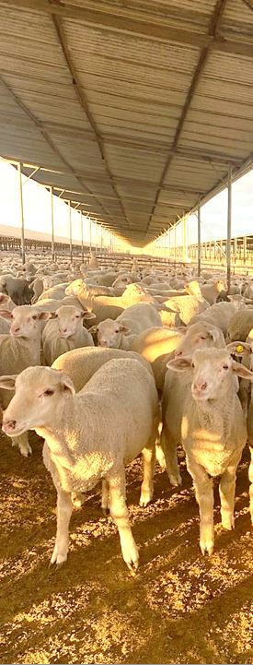

Content
  Financial Performance Profit & Loss
  Statement of Financial Position

Slide 4
FINANCIALS RESULTS
  Q1/22 on Q1/23 Commentary
  Total Revenue grew QR 22m primarily driven by International Sales.
  GM has been impacted, as Widam reduces sales prices to counteract stock clearances by competitors.
  OpExp and G&A cost management achieved a reduction of 5 %

Slide 5

Statement of Financial Position 31 MARCH 2023
Q4/22 vs Q1/23 Commentary
Inventory: Reduction in FIFA acquired Inventory through stock clearances in Q1
AR & Prepayments:
Increase in Supplier Advances for
increase International Sales expected
in Q2/2023
Trade Receivables are steady quarter
on quarter.

Slide 6
Statement of Financial Position 31 MARCH 2023
Q4/22 vs Q1/23 Commentary
Islamic borrowing increase to support business Cash requirements.
Fair Value Reserve: Impacted with change in Baladna share price.

Slide 7
Disclaimer
This presentation has been prepared for information purposes only and is not and does not form part of any offer for sale or solicitation of any offer to subscribe for or purchase or sell any securities nor shall it or any part of it form the basis of or be relied on in connection with any contract or commitment whatsoever.

Slide 8
Thank You

