Slide 1
INVESTORS CONFERENCE CALL
For the year ended 31 December 2022
Presented by: Amar Kulkarni, Finance Director

Slide 2
ABOUT US
Widam Food Company Q.P.S.C. (the “Company”) was incorporated in accordance with the Resolution No. 75 of 2003 issued by the Minister of Economy and Finance of the State of Qatar as a Qatari Public Shareholding Company, and was registered at the Ministry of Economy and Commerce of the State of Qatar with the Commercial Registration No. 26911 dated 16 December 2003. The Company is domiciled in the State of Qatar, where it also has its principal place of business. Its registered office is at Fifth floor, Al Shomoukh Tower, Al Saad, Doha.
The Company’s principal activities include the import and trade of livestock, meat and feeds. In addition the Company is engaged in the slaughter of sheep and cattle and supplying the local market with fresh meat and related products

Slide 3
MANAGEMENT COMMENTARY - 2022
HIGHLIGHTS
2022 was impacted with low Domestic sales but compensated with International Sales.
Opportunities envisaged by many during the World Cup, many new competitors entered the market leading to increased domestic competition. Costs were impacted with the Russian/Ukraine war throughout Q2-Q4. Logistic costs increases with the World Cup rush further impacted the business. Domestic demand was substantially lower than expected driving clearance of stock before expiry, bringing about low gross margins
Overall Revenue rose by 15 % YoY. The company posted overall revenue of QR 483 mn increasing by 15 % YoY. Sales of government compensated items rose by 17% YoY, non-compensated items rose by 15% YoY driven mainly by International sales. Sales of Domestic non-compensated items declined by 10% YoY.
Gross margin (after government compensation) recorded at (5)% vs. (7)% in 2021.
Expenses declined vs 2021. Stringent cost controls and careful internal process planning and changes has driven a cost saving of over 15 mn. Operating expenses declined YoY by 13% . G&A declined YoY by 11% .

Slide 4
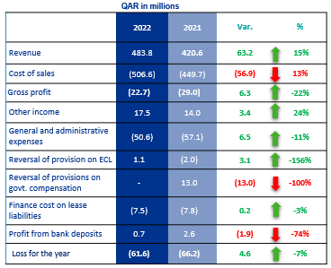
FINANCIAL HIGHLIGHTS –
STATEMENT OF PROFIT & LOSS and OTHER COMPREHENSIVE INCOME
YoY ANALYSIS
Revenue has increased mainly due to support from International Sales. Domestic sales has been weaker than expected even during the World Cup. International Sales booked at 100 mn vs 10 mn in 2021.
The cost of sales increased as a result of increase in revenue during the period, albeit at a reduced percentage versus revenue. Increase in cost of Logistics and Food inflation rates worldwide increased cost of sales unproportionate to revenue.
The Operation Expenses decreased 13% with efforts on financial controls and supplier contract renegotiations.
The G&A Expenses decrease 11% mainly related to stringent finance cost controls and cost monitoring.
Loss for the Year – QR 61 mn vs QR 66 mn, is important to be assessed on the back of QR 13 mn reversal of provision in 2021. Hence a true comparative is QR 61 mn loss 2022 vs QR 80 mn loss in 2021. A 25% reduction in loss in 2022.

Slide 5
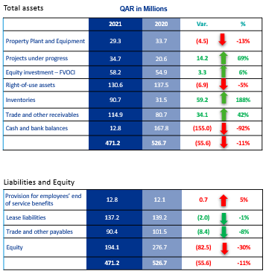
FINANCIAL HIGHLIGHTS – FINANCIAL POSITION
ANALYSIS vs 31 Dec 2021
Projects under progress have increased by 1.2 M mainly with the initiation of ERP implementation. The new Cold Storage Facility in Al Wakra and Slaughterhouse in Abu Nakhla amounting to QR 10 M. The additional increase pertains to additional barns expansion, weight bridge setup in Sudan amounting QR 2 M.
The increase in the Equity investments of QR 8.1 M is due to the increase in the fair value of the share price of Baladna Company as at 31 December 2022.
Right of use assets have decreased due to depreciation charge during the period.
The increase in Inventory resulted from an increase in Inventory at Widam Sudan for International Sales expected in Q1/2024. Purchase of Australian Livestock of QR 10 M. Purchase of Frozen stock build up for Q4 during the World Cup.
The increase in trade and other receivables is mainly related to the increase in Advance to suppliers of 32 M and trade receivables by QR 11 million.
The decrease in the cash balances as at 31 December 2022 compared to 31 December 2021 results from build up of Inventory, advances to suppliers and increase in receivables.

Slide 6
Disclaimer
This presentation has been prepared for information purposes only and is not and does not form part of any offer for sale or solicitation of any offer to subscribe for or purchase or sell any securities nor shall it or any part of it form the basis of or be relied on in connection with any contract or commitment whatsoever.

Slide 7
Thank You
Presented by: Amar Kulkarni, Finance Director

